Slide 1
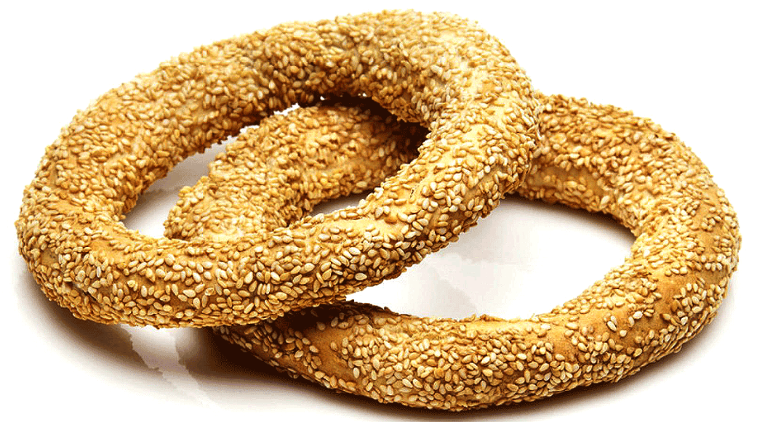
Microcalcification detection, clustering and features extraction
Presentation of 28/07/2023
Thanks for the Koulouri Grigorios!!

Slide 2
I) Background, reminder of last meeting
II) Analysis, tries and improvements on python code
Deeper analysis in threshold use of CALC1
Trying new clustering techniques in python
III) Solution 2 finished !!!
Making a properties list in python, from python to matlab, adapt to HPV (FeDeG) form of data
Why keeping and clustering on those specifics characteristics
Results (GUI.m)
IV) New metrics : SPIAT (R code)
AMD: Average Minimal Distance
McIN, APD
Extract those metrics from new HPV clusters outputs
V) Dicoms Data?

Slide 3
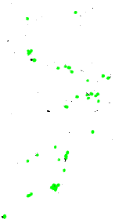
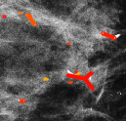
I) Background, reminder of last meeting
Last time :
More precise presentation and critics of first solution
Advance on second solution
New way of clustering directly on python
Settled objectives :
Have a look on how the threshold works in CALC1
Finding interestics metrics (SPIAT -> new paper)
Pursue with HPV (FLOCK) -> second solution
Output of segmentation (step 1) on first solution
Output of first solution

Slide 4
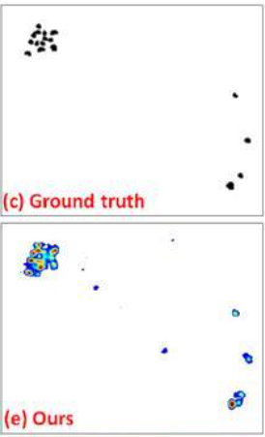
II) Analysis, tries and improvements on python code
1) Deeper analysis in threshold use of CALC1
There is not such thing as a threshold used for the output in CALC1 initial code, indeed in the corresponding article it’s written down that the output is a « calcification probability », so not a binary output:
Actually there is a threshold value: «th=.5 » in the function show_mamm_w_boxes line 178 of core.py file, but it’s only used at the end for a view of the MC on the mammogram (last bloc of jupyter script),
**Show codes on Jupyter**
Therefore, because we need a binary output, we need to perform a binarisation with a threshold as described during last meeting, I chose to stay at 0.4 regarding the histogram values and because they were using .5 and I wanted to put the threshold lower to have more MC
**Show codes on Jupyter**
Figure in CALC1 article where you can see the non-binary output
-Adapting the threshold for new dataset will most likely become necesssary
-Keeping the probabilty aside of the binarized output might be interesting to make an average probability of MC as a feature for clustering ?

Slide 5
2) Trying new clustering techniques in python
7 new clustering techniques in python have been tried since last time (AgglomerativeClustering was the one presented last time) :
-AgglomerativeClustering
-DBSCAN
-KMeans
-MeanShift
-SpectralClustering
-AffinityPropagation
-Birch
-MiniBatchKMeans
**Show codes on Jupyter**
Even if most of those are pretty performant, only 3 work with non pre-fixed numbers of clusters. Which is something we look for because we are interested in the characteristics of those clusters not at all the number of clusters
Only 3 are in this case :
-DBSCAN -> works
-MeanShift -> too long computation time
-AffinityPropagation -> works
Actually MeanShift is the one used in HPV (FLOCK) code (even if they make their own version MeanShiftCluster_v3.m ) so the one we would try in priority

Slide 6
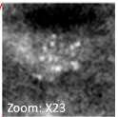
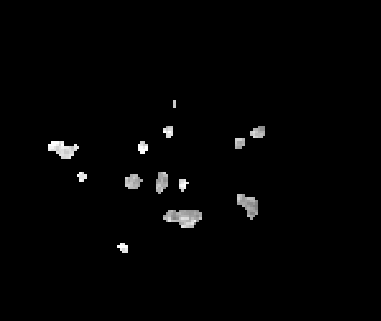
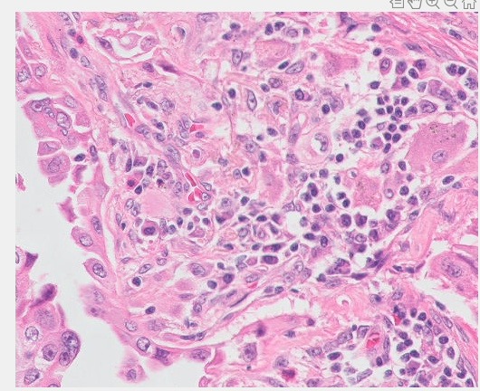
III) Solution 2 completed
The first one (easier) has already been fully implemented and the results were presented last time
Quick reminder of what were the 2 solutions proposed at the end June :
CALC1
Microcalcification detection
First Solution:
Adapt CALC1 output and step1 code
Second Solution:
Obtaining compatible properties and structures
HPV - Step 2
Grouping in cluster & computing characteristics on clusters
-List of compatible properties
-List of nuclei
HPV - Step 1
Dots segmentation & Characterisitics

Slide 7
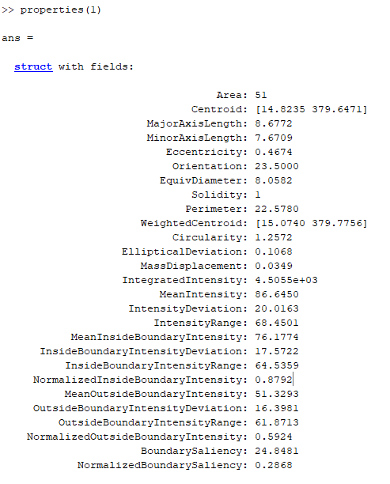
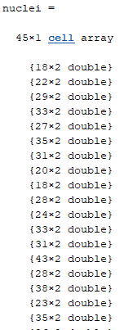
1) Making a properties list in python, from python to matlab, adapt to HPV (FeDeG) form of data
In order to directly enter in step 2 of HPV, exact same features must be extracted from python output and stored in the same structure as below :
A first, a complete list of characteristics (even if I’m not sure of how I calculated the last properties) has been implemented in python
But after having a deeper look in FeDeG article, I have settled to work on less features at first (more pertinent features in the case of MC for clustering and lighter for the data ) and make a second, shorter features list presented later on
Equivalent: MC_properties
Equivalent: MC_pixels_coordinates

Slide 8
Most of the properties are calculated this way, or by hand:
**Show codes on Jupyter**
Then they are stored line by line in a txt file (for matlab, no pyckle)
**Show codes on Jupyter
And drive folder**
2 functions :
-HPV_load_properties_of_MC.m : to load the properties from the txt file in the expected format by HPV/FeDeG
-HPV_load_MC.m : Same but for all the index of each pixels of MC, surprisingly the hardest to implement because of the strange format
**Show matlab code**

Slide 9
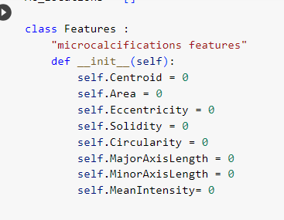
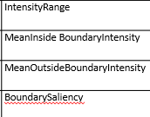
2) Why keeping and clustering on those specifics characteristics
Selected features
Not sure of how pertinent Solidity is: because most of the MC are compact
Histogram of values
Those parameters haven’t been considered in the second list but might be in the future to consider the close neighborhood:

Slide 10

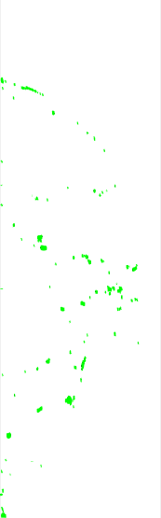
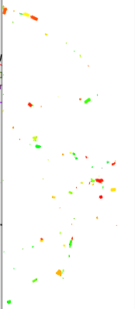
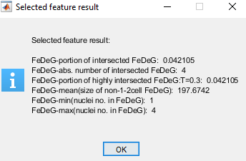
3) Results (GUI.m)
Just have to comment the first line and add those 2 lines to make it work (either in show_exampleV2.m or GUI.m and run:
Here are the results:
**Show the use of GUI.m**
Clusters and FeDeG with last option and h_s=40
Zoom on the clusters and try different h_s size to have a better idea of what’s happening!
After ‘segmentation’
To compare with: solution 1

Slide 11
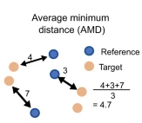
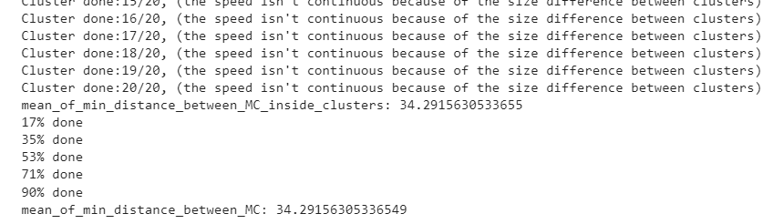
IV) New metrics : SPIAT (R code)
1) AMD: Average Minimal Distance
Implemented, right now :
- AMD between all the MC of the image (border to border and not centroid to centroid) - AMD between a specific cluster requested
AMD of MC inside their cluster
Soon :
- AMD between all the clusters of the image (border to border also)
Figure of SPIAT publication
**Show Jupyter code**
Implemented by hand in python-> need adaptation if the clusters studied are the outputs of HPV/FeDeG code

Slide 12
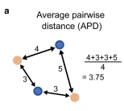
2) McIN, APD
McIN =Numbers of MC (could also be cluster ) within a given radius R
-> Implementation finished soon
-> How do we chose R? -> AMD*1,5 or 2?
APD = Average Pair Distance
-> Usefull?
SPIAT figure
3) Extract those metrics from new HPV clusters outputs
Next step is to pass the clusters (output of HPV/FeDeG) from Matlab to python to extract those additionial characteristics on python

Slide 13
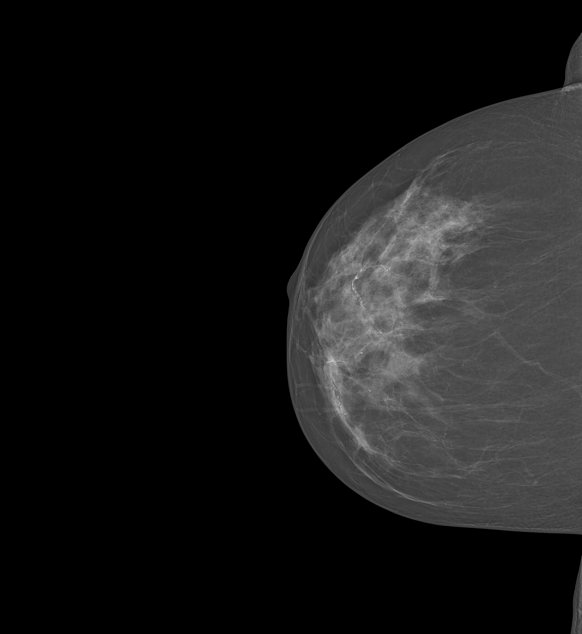
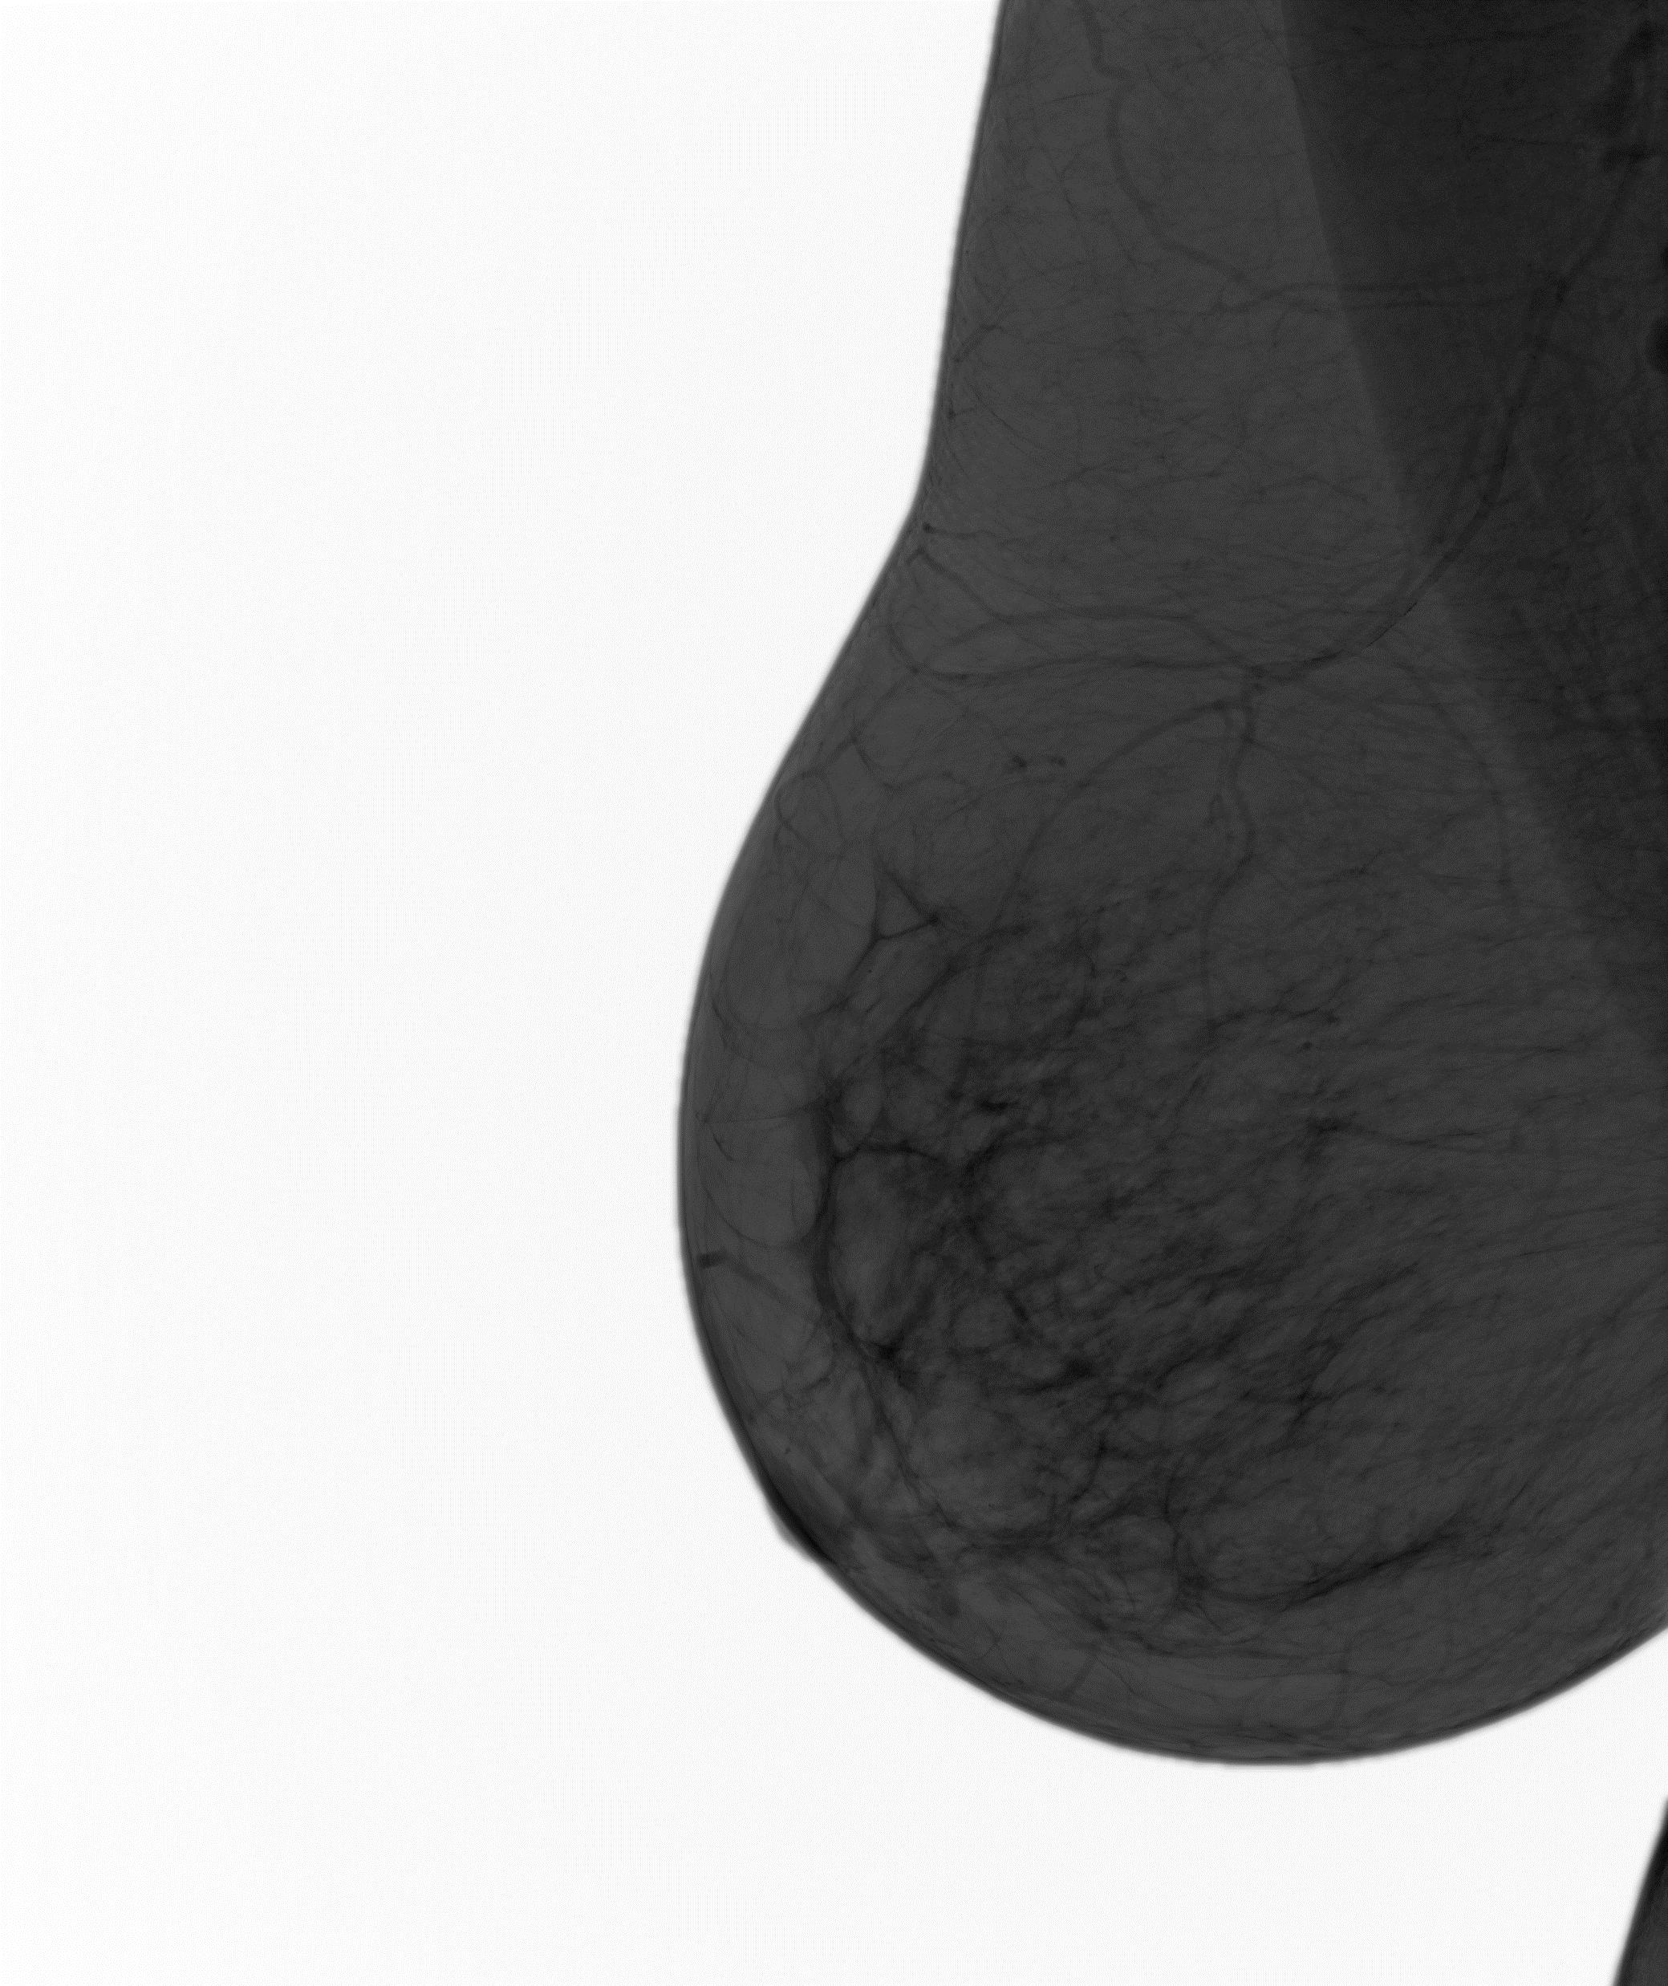
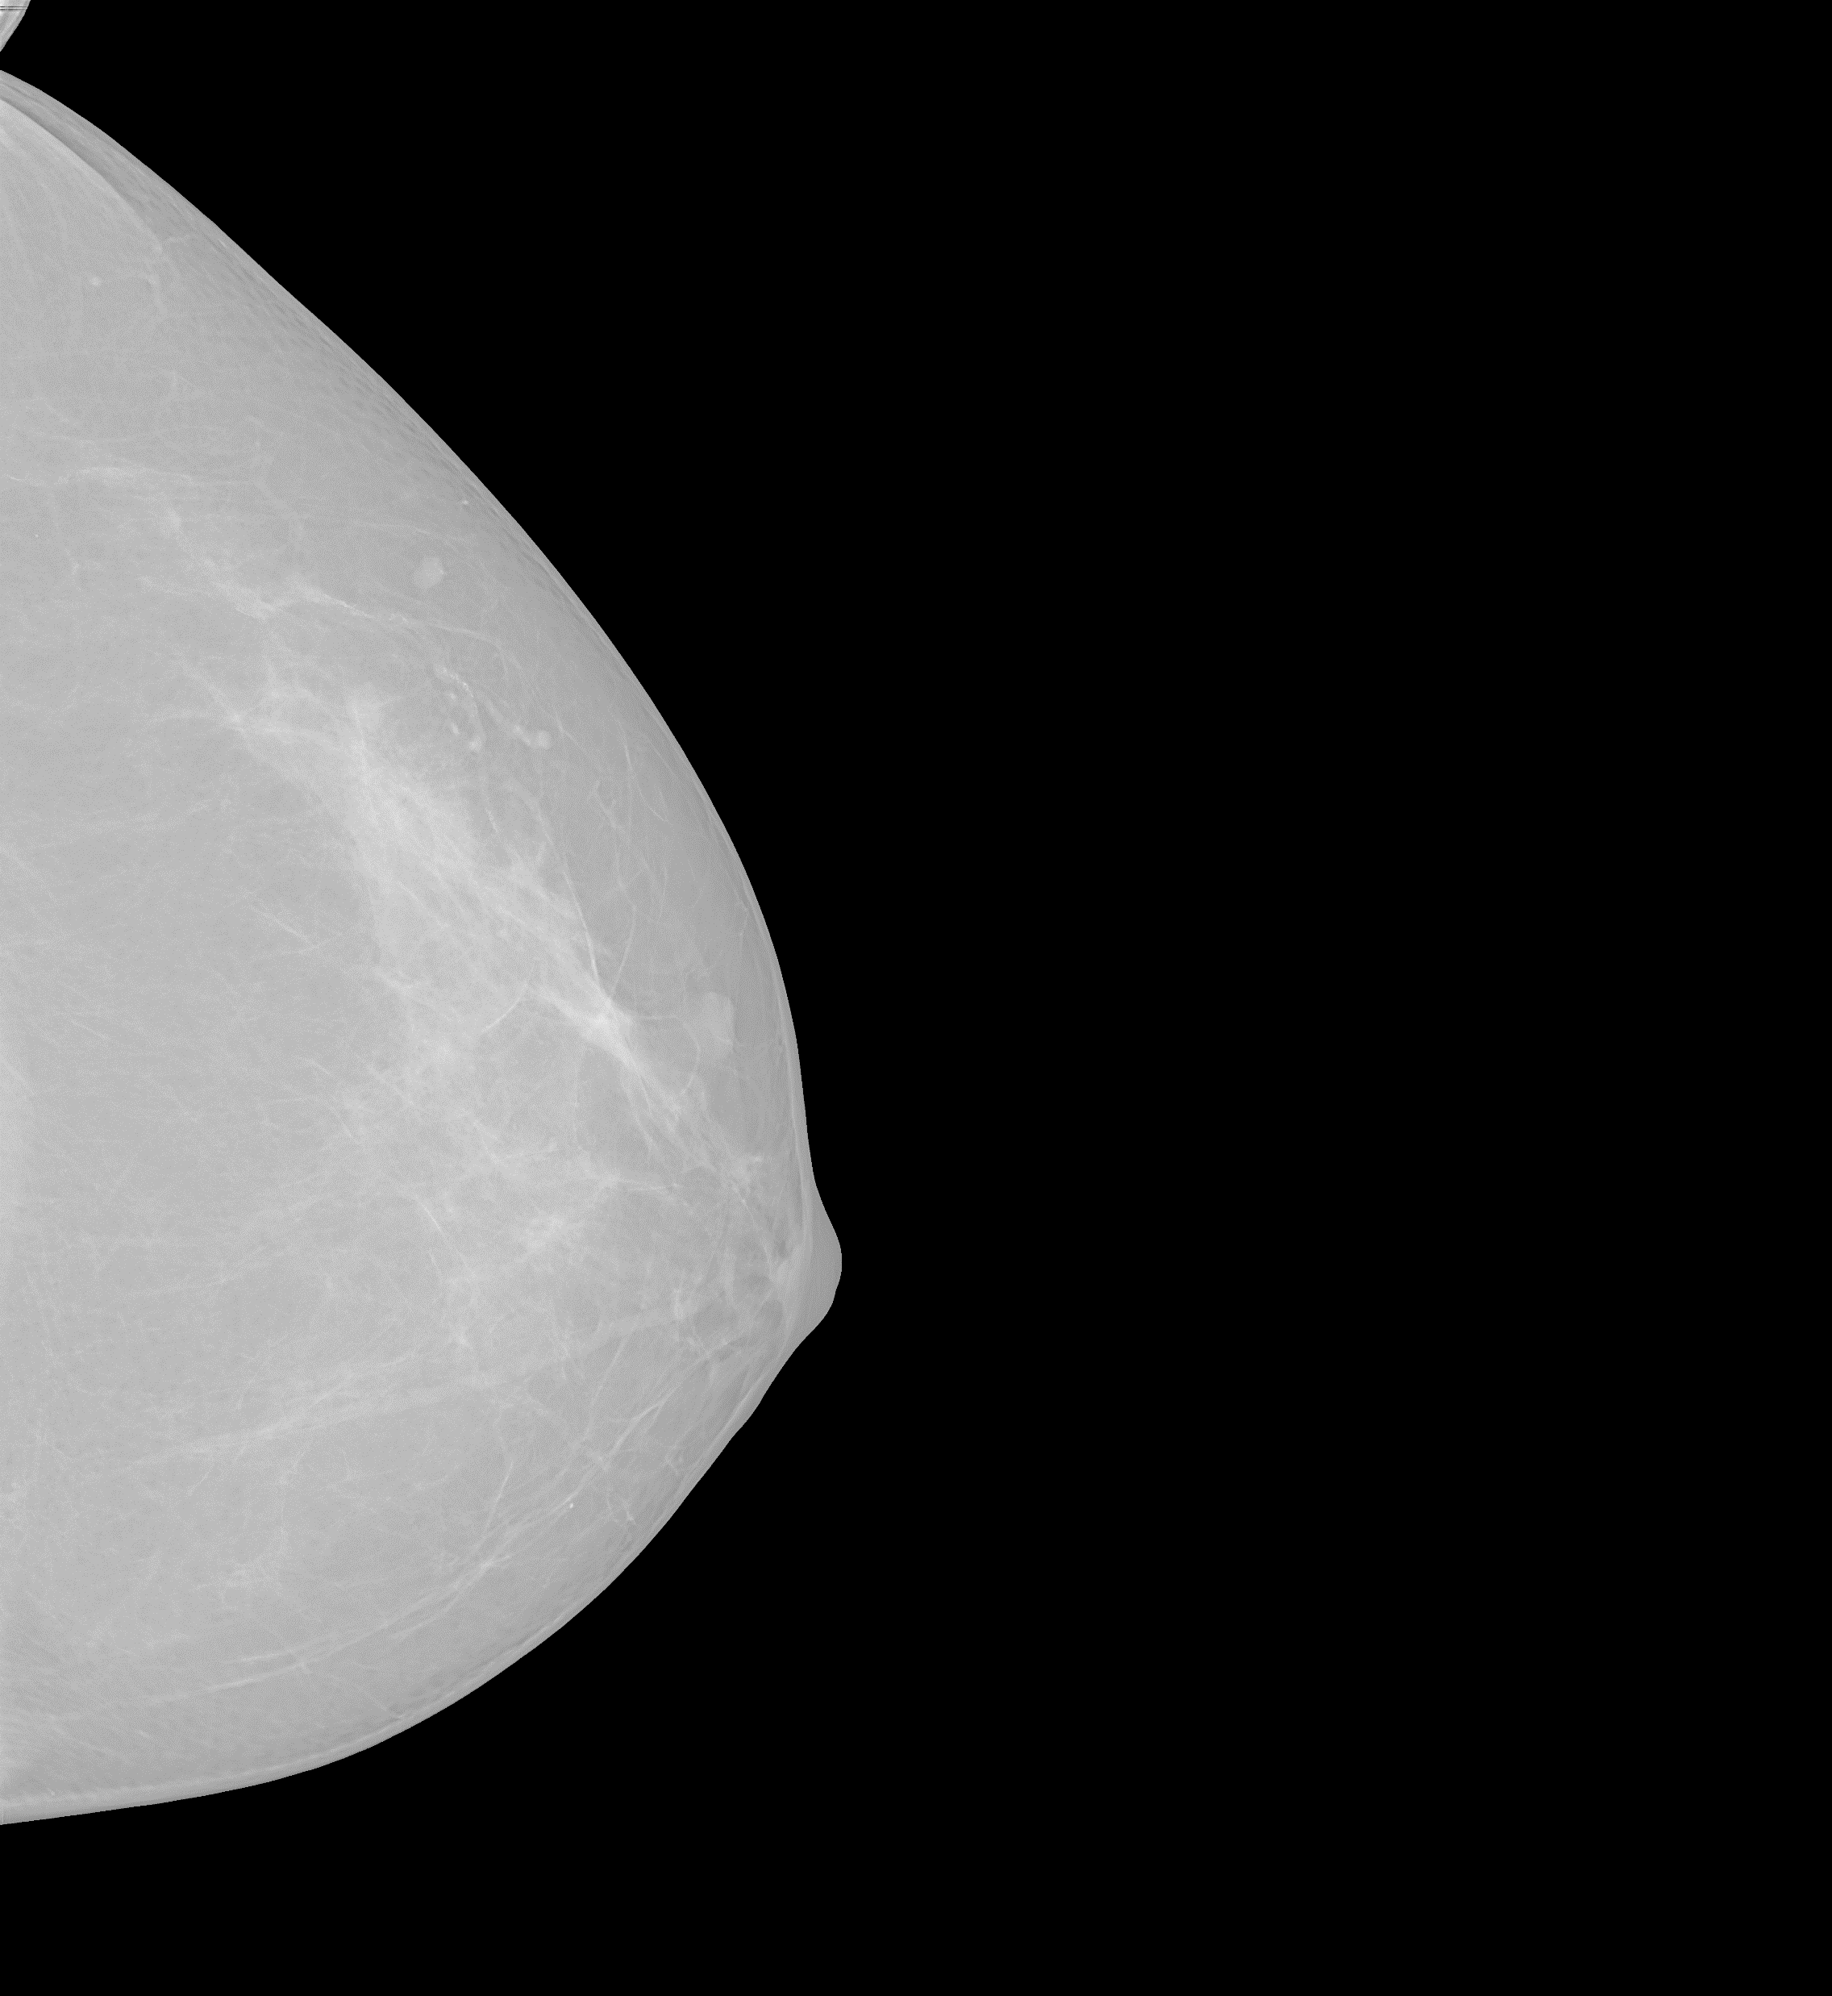
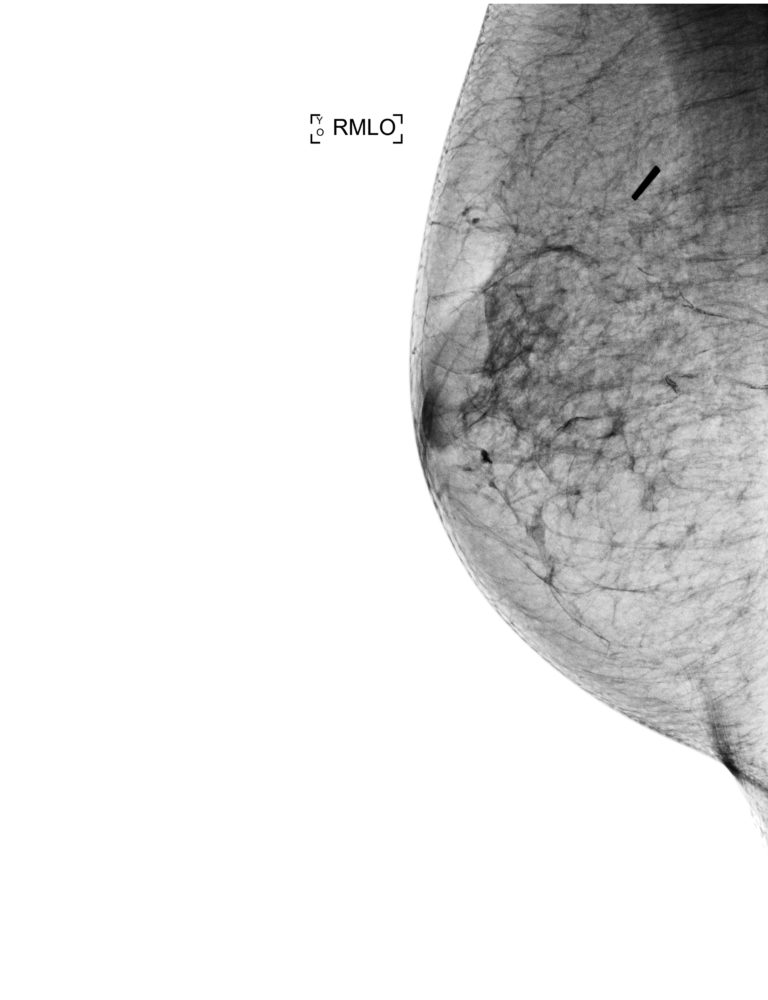
V) Dicoms Data?
-Still problems with the size of Dicoms dataset but as soon as it’s working we will try to apply the precedent described methos on it
-> adapt the threshold, the clustering parameters probably

